Slide 1
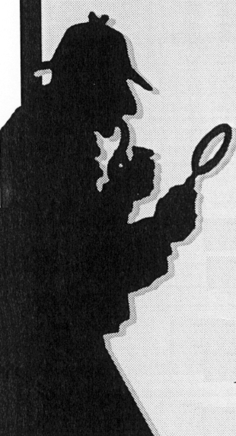
Sherlock Holmes’
7 Rules of Scientific Thinking
(compiled by John Sherwood)

Slide 2
1. “One should always look for a possible alternative and provide against it. It is the first rule of criminal investigation.”

Slide 3
2. “I never guess. It is a capital mistake to theorize before one has data. Insensibly one begins to twist facts to suit theories, instead of theories to suit facts.”

Slide 4
3. “Use your time sparingly. Determine what you have. Then determine what you need. Then look for what you need in the place where it must be.”

Slide 5
4. “There is nothing so important as trifles. Never trust to general impressions, but concentrate yourself upon details.”

Slide 6
5. “Singularity is almost invariably a clue.”

Slide 7
6. “It is a mistake to con-found strangeness with mystery. The most common- place crime is often the most mysterious, because it presents no new or special features from which deductions may be drawn.”

Slide 8
7. “When you have eliminated the impossible, whatever remains, however improbable, must be the truth.”

